Slide 1




ADD COMPANY NAME
ATM System
Prepared By :
(RCPIT Batch 25)
Neha Chaudhari
Kamini Patil
Prerana Wani
Disha Bherde
Harshada Chaudhari
Hemangi Bhadane
Harshada Patil
Guided By :
Mr. Rajeev Shishodia

Slide 2


Purpose
To provide a convenient and accessible way for bank customers to perform various financial transactions without the need for human assistance.

Slide 3

Objectives
Accuracy
User Convenience
Scalability
Accessibility
Reliability
Objectives
Customization

Slide 4
With Draw
Deposit
Change Pin
Check Balance
Mini Statement
Functionality

Slide 5

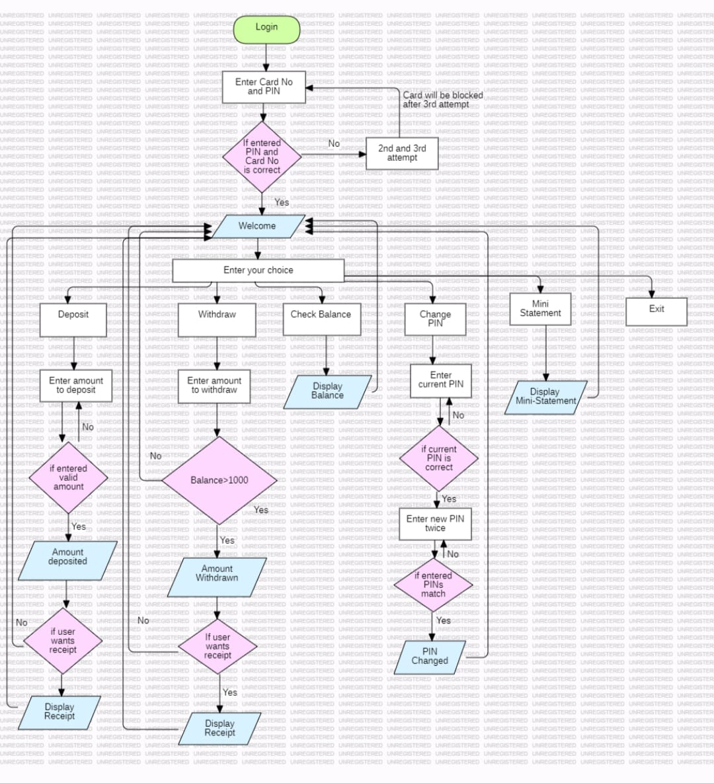
Flow Diagram

Slide 6
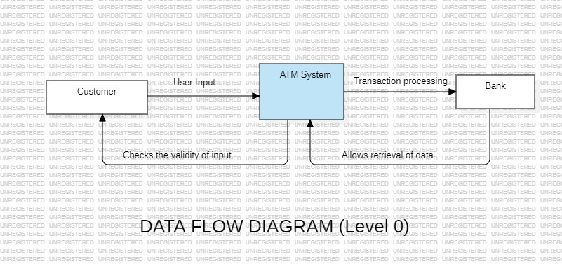
DFD Diagram
( Level 0 )

Slide 7
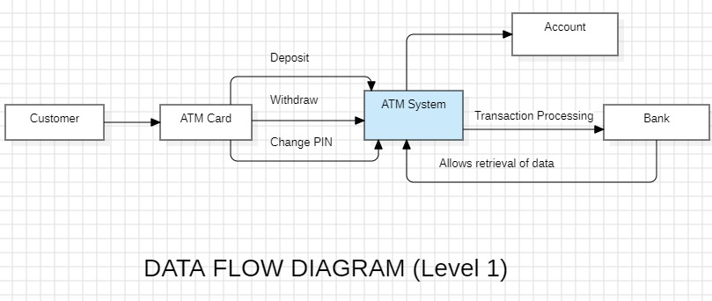
DFD Diagram
( Level 1 )

Slide 8
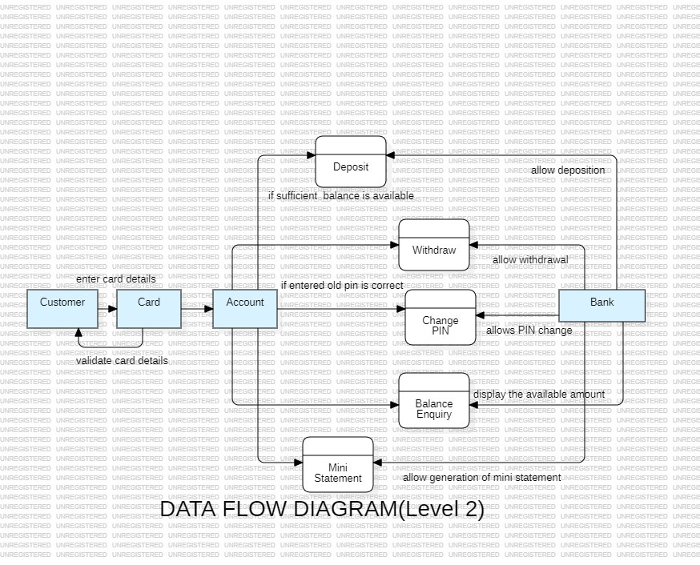
DFD Diagram
( Level 2 )

Slide 9

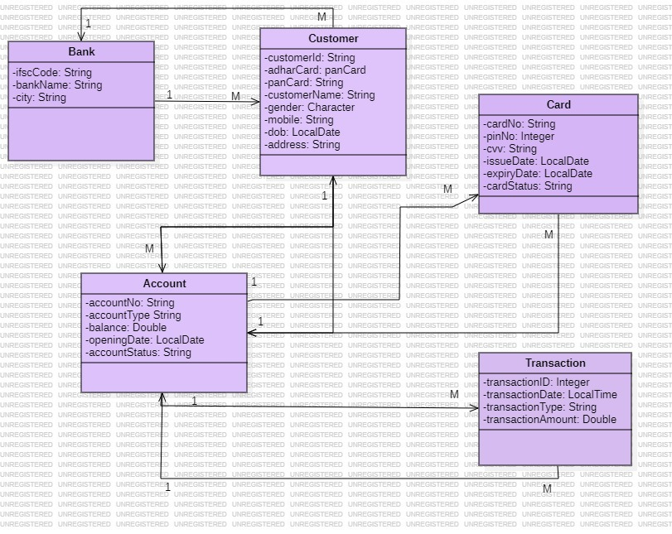
Class Diagram

Slide 10
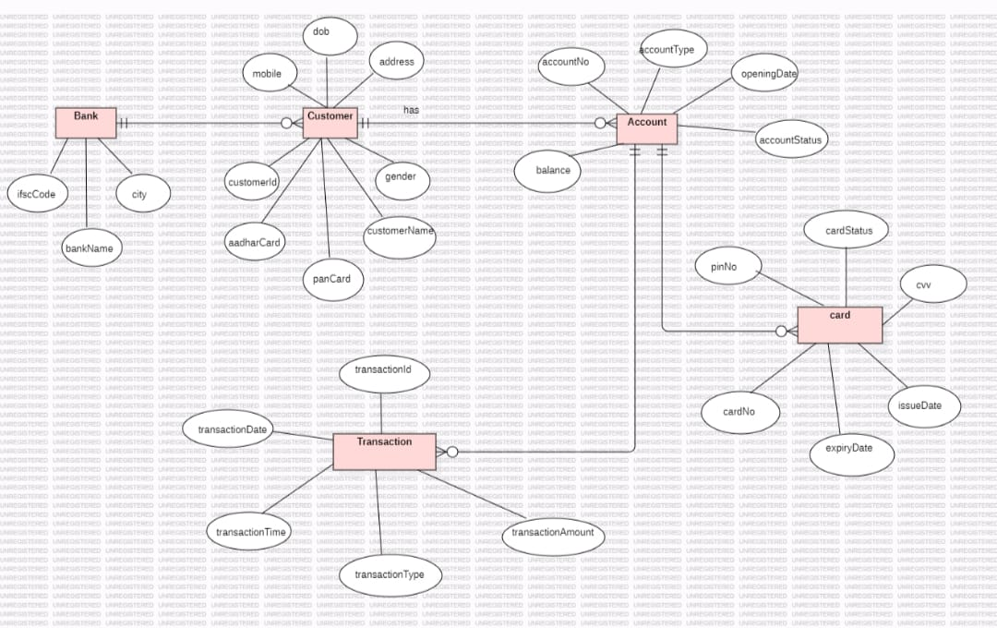
ER Diagram

Slide 11
Test Cases
Excel Sheet

Slide 12


Thank You

